Slide 1



Please download and install the Slido app on all computers you use
Join at slido.com
#2582805
ⓘ Start presenting to display the joining instructions on this slide.

Slide 2
Welcome to our ABP Community Breakfast

Slide 3




Today’s primary sponsors
Welcome - & thank you!

Slide 4



Good News and Great Service

Slide 5



Updates
careers@ferryhill.school
23rd – 27th June
BPACT
Businesses, Police and Communities Together

Slide 6

Chris Perry
Business Engagement and Account Manager
Business Durham

Slide 7




DURHAM BUSINESS
Helping you generate
higher profits & faster growth through better productivity.
Durham Business Growth will help you to achieve your productivity and growth aspirations through our dedicated team of experts who are here to help you unlock the full potential of your business.

Slide 8


Productivity & Growth Support
Specialists will help develop actionable plans to improve productivity, reduce carbon emissions and generate growth.
Decarbonisation Support
The programme will fund external technical experts to deliver energy audits and decarbonisation plans.

Slide 9


Revenue Grants
Available between £1k and £10k for costs associated with engaging external experts.
Capital & Hybrid Grants
Available between £10k and £200k for costs associated with plant, machinery, equipment, premises and fit-out works.

Slide 10

Eligibility
We welcome businesses of all sizes and across a diverse array of sectors who are trading in or planning to move to County Durham.

Slide 11
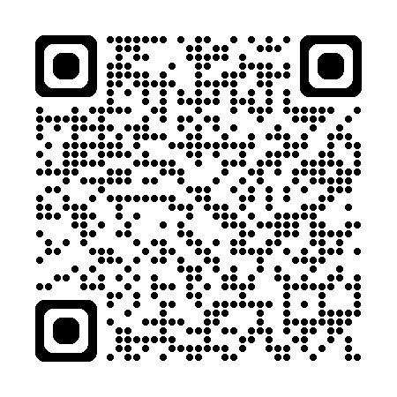
To find out more Visit
www.durhambusinessgrowth.co.uk

Slide 12
Education panel interview with Martin Walker
Dr Suzanne Hague – Teesside University
Ian Nelson – NC Group Ltd.
Shaun Hope – Bishop Auckland College
Lucy Johnson – North-East Combined Authority (NECA)

Slide 13

Please download and install the Slido app on all computers you use
Do you think all children should stay in education longer?
ⓘ Start presenting to display the poll results on this slide.

Slide 14
Please download and install the Slido app on all computers you use
Have you heard of LSIP - Local Skills Improvement Process?
ⓘ Start presenting to display the poll results on this slide.

Slide 15

Please download and install the Slido app on all computers you use
Audience Q&A
What questions do you have for the panel?
ⓘ Start presenting to display the audience questions on this slide.

Slide 16
Please download and install the Slido app on all computers you use
What is your appetite for taking on apprentices every year?
ⓘ Start presenting to display the poll results on this slide.

Slide 17

Make Your Mark Awards 2025
Hardwick Hall – 8th May

Slide 18



Work Package Opportunities:
Blinds
Decoration
Mastic
Cleaning
Fire Stopping
Plaster/Internal Walls/Partitions
Landscaping
Fencing
External Doors and Shutters
If you would like to find out more details, or register interest in any of the packages above, please contact Euan Granger (Supply Chain Manager, North East & Cumbria) at euan.granger@morgansindall.com.

Slide 19
hello@aycliffebusinesspark.co.uk
Sponsorship, Good News stories, “On the Map”
Please check your Junk!!

Slide 20
Thank you for joining us! save the date...
Friday 23rd May - 8am – 10am

